Slide 1
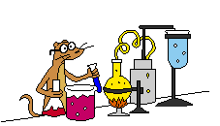
Welcome to Chemistry
SCH 3U0

Slide 2

To expand our knowledge of chemistry we must first reinforce our understanding of old concepts!
Let’s review…

Slide 3
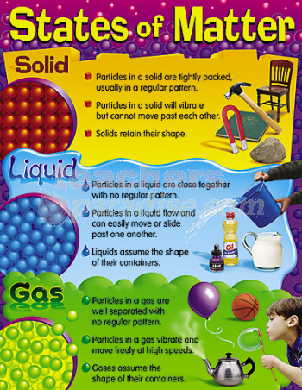

Slide 4
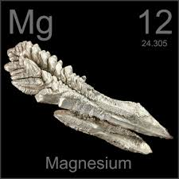
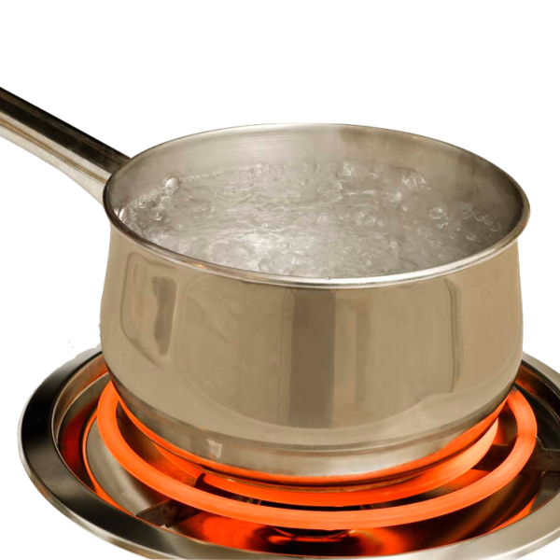
QUALITATIVE vs QUANTITATIVE
Qualitative:
  Describe using words
    Magnesium is silver in colour.
Quantitative:
  Describe using numbers
    Water has a boiling point of 100° C.
    The density of iron is 7870 kg/m³.

Slide 5
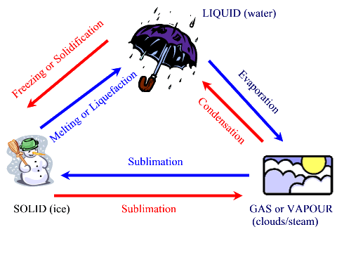
PHYSICAL CHANGES
Alter or affect the form or state of a substance
e.g. melting, dissolving,, breaking a rock into smaller pieces

Slide 6
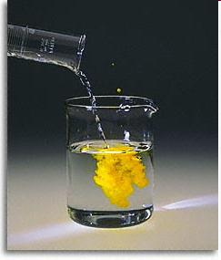
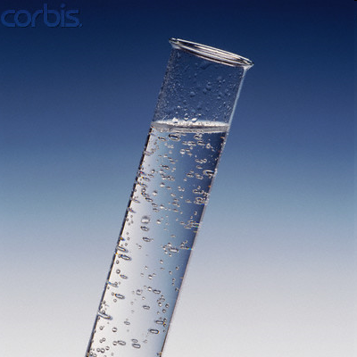


CHEMICAL CHANGES
transform a substance into a new substance
the new substance has different chemical properties
e.g. milk sours, wood burns, iron rusts
Look for proof!!

Slide 7
PHYSICAL vs CHEMICAL PROPERTIES
Physical property
  description that helps to identify a substance
    e.g. colour, state, boiling point
    determined without changing the substance into another substance
Chemical property
  how a substance reacts with other substances to form new substances
  the process by which the substance change is called a chemical reaction

Slide 8

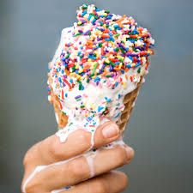
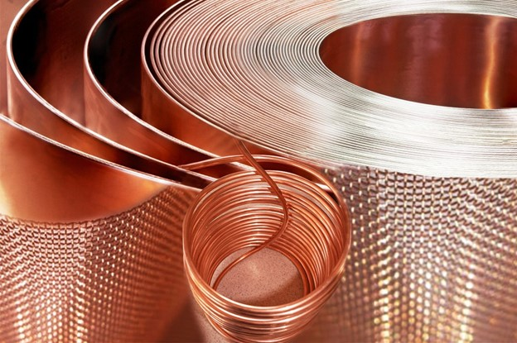
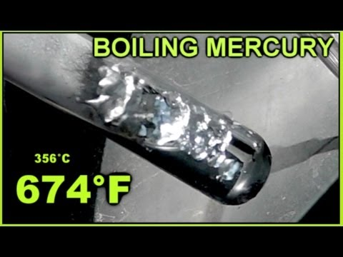
PHYSICAL PROPERTIES
Malleability: a solid that can be hammered/bent into different shapes
Ductility: a solid that can be pulled into wires
Melting/boiling points: temp at which a substance melts or boils

Slide 9
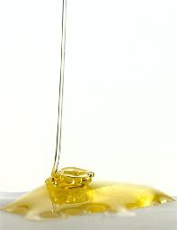
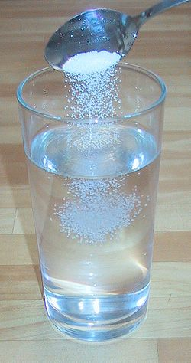
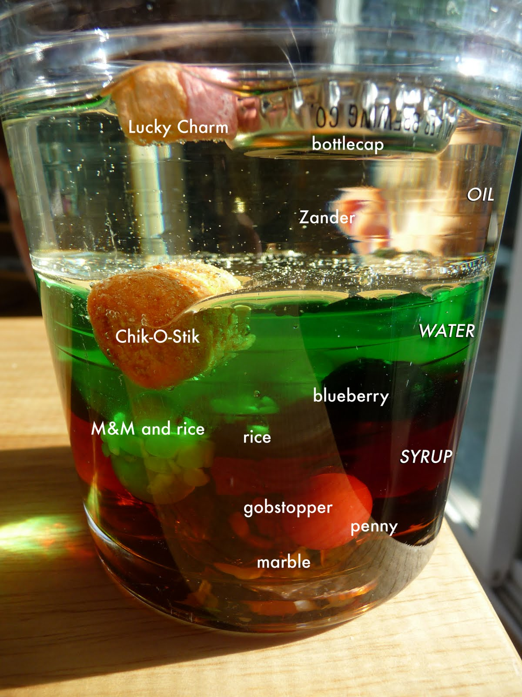
PHYSICAL PROPERTIES
Solubility: ability of a substance to dissolve in a solvent such as water
Density: how much heavier the particles of one substance are over another
Viscosity: how easily a liquid flows (thicker liquid is more viscous)

Slide 10
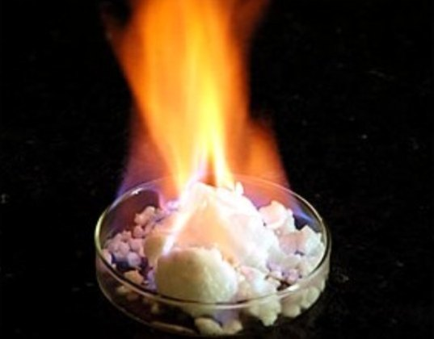
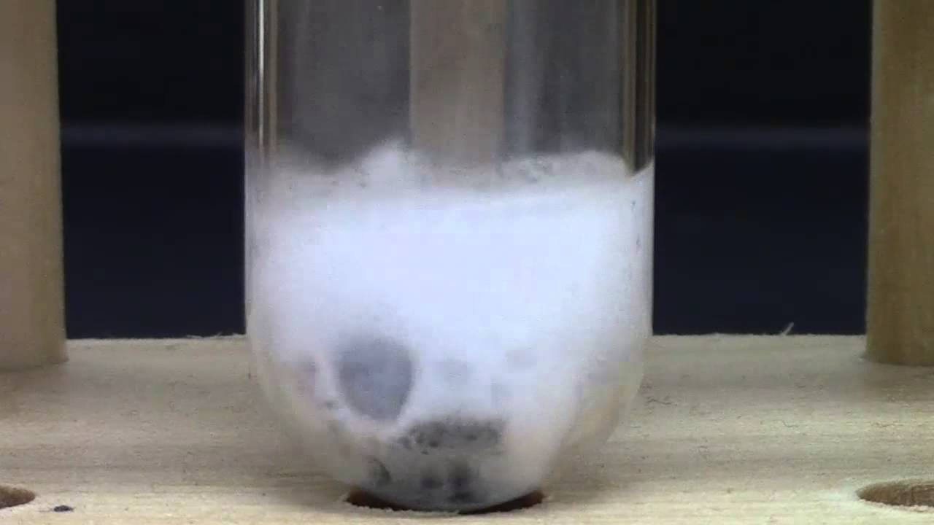
CHEMICAL PROPERTIES
Combustibility: a substance that burns when exposed to a flame
Reactivity with acid: metals react with acid to produce a gas

Slide 11
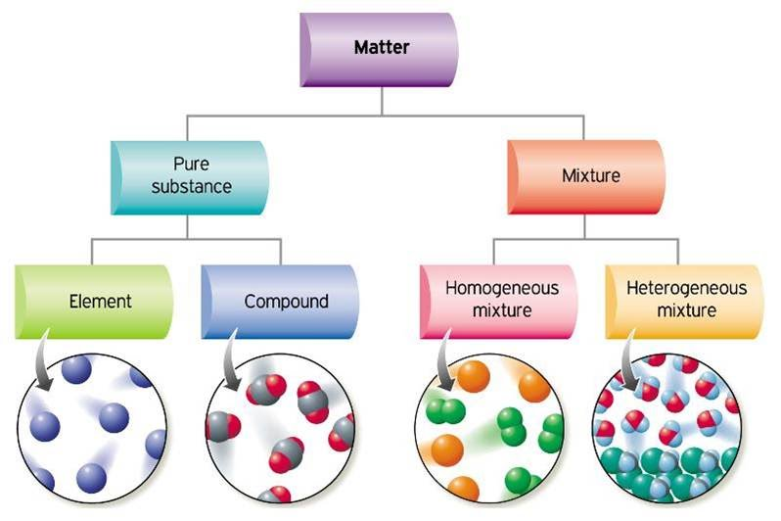
CLASSIFICATION OF MATTER

Slide 12
CLASSIFICATION OF MATTER
Matter: anything that takes up space and occupies volume
Pure substances: only made of one type of particle
Mixtures: made of different types of particles

Slide 13
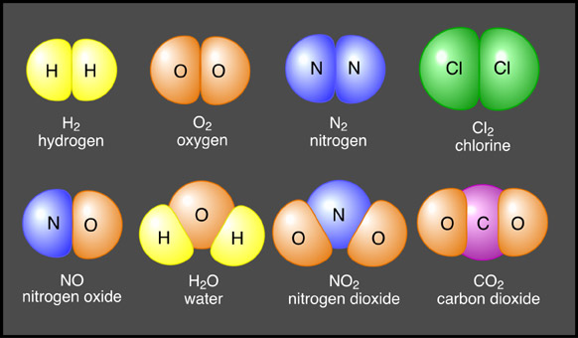
CLASSIFICATION OF MATTER
Elements: made up of atoms
Compounds: made of two or more elements

Slide 14
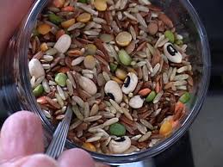
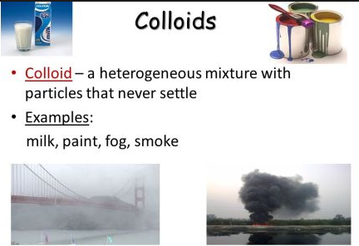
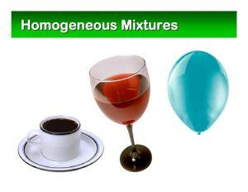
CLASSIFICATION OF MATTER
Heterogeneous Mixtures: many phases
Homogenous Mixtures (Solutions): only 1 phase

Slide 15
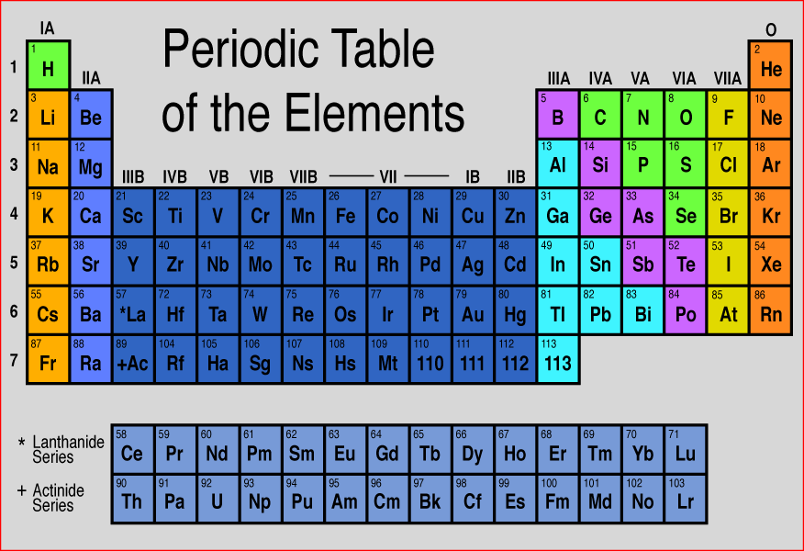
THE PERIODIC TABLE
Lists elements in order of increasing ATOMIC NUMBER

Slide 16
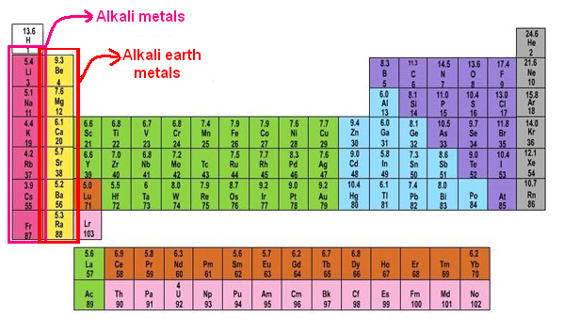
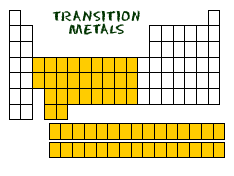
METALS - FAMILIES
Elements in the same COLUMNS have similar properties and are called families…
Alkali metals:
  Very reactive
Alkaline earth metals:
  Not as reactive
  as Alkali metals
  Transition metals

Slide 17
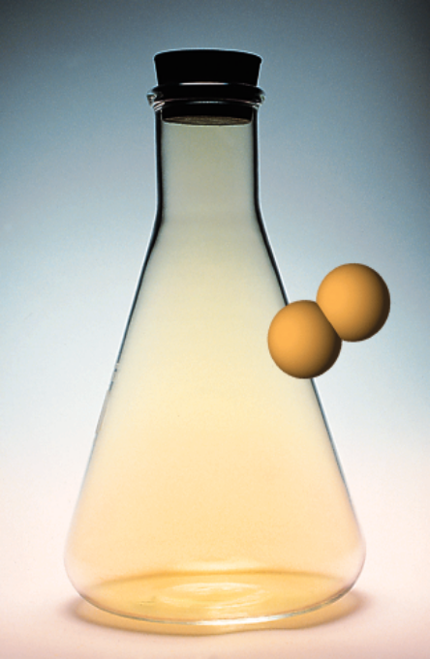
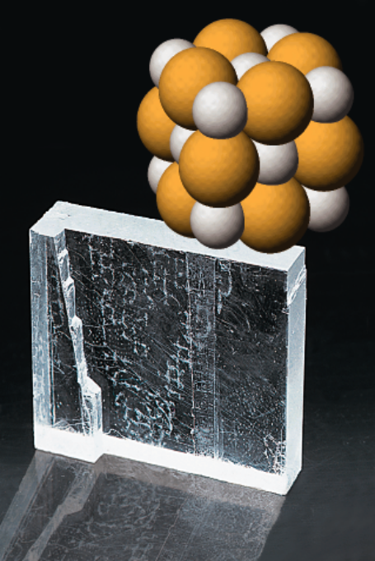

NON-METALS - FAMILIES
Halogens
  Column 17
  HIGHLY REACTIVE
Noble Gases
  Column 18
  NOT reactive at all

Slide 18
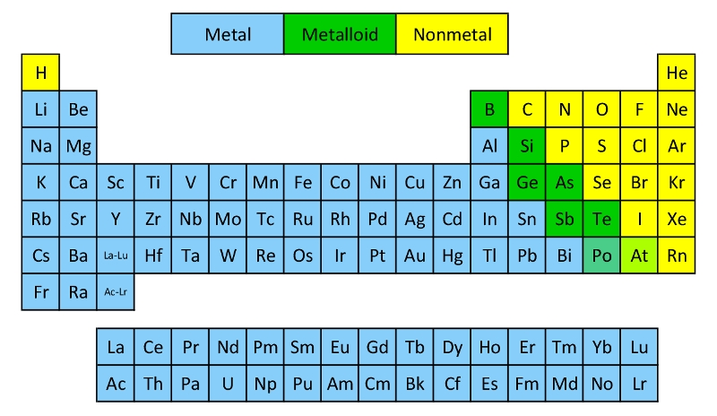
OTHER…
Metalloids
  On the staircase
  Have both metal and non-metal like properties

Slide 19
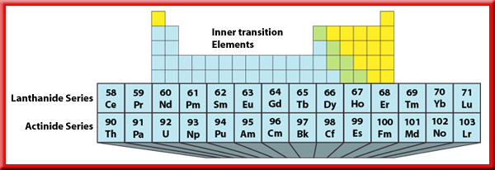
Inner Transition Elements
The first series of elements: lanthanides.
soft metals that can be cut with a knife.
so similar that they are hard to separate when they occur in the same ore, which they often do.
The second series of elements: actinides.
All are radioactive.
The nuclei of atoms of radioactive elements are unstable and decay to form other elements.

Slide 20
MODERN ATOMIC THEORY
John Dalton: 1800
All matter is made up of atoms
Atoms of an element are identical to each other
Elements combine in constant ratios to make compounds
Atoms are rearranged in reactions

Slide 21
We will review some of this later
Democritus
Aristotle
Dalton: billiard ball
Thomson: plum pudding model
Rutherford: gold foil experiment
Bohr: specific energy levels
Chadwick
Schrödinger: electron clouds

Slide 22
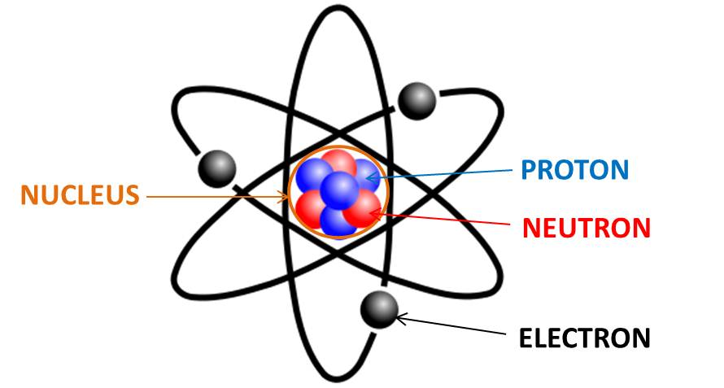
ELEMENTS are made up of…
Atoms
  Protons (+ charge)
  Neutrons (no charge)
  Electrons (- charge)

Slide 23
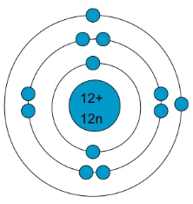
BOHR RUTHERFORD DIAGRAMS
Electrons drawn in circles/orbits around nucleus
1st orbital holds a max of 2
2nd orb holds a max of 8
3rd orb holds a max of 8
(the model we will use for now…)
# of protons and neutrons written in the nucleus

Slide 24
REMINDERS
Proton # = Atomic #
Electron # = Atomic #
  (this changes in IONS)
Neutron # = Atomic Mass - Atomic #

Slide 25
Word Equations
describes chemical change using the names of the reactants and products.
Write the word equation for the reaction of methane gas with oxygen gas to form carbon dioxide and water.
methane + oxygen carbon dioxide + water
Reactant
Product
We will learn about subscripts – state of matter
(s) – solid (l) – liquid (g) – gas (aq) – aqueous
(∆) sometimes found above arrow - heat added

Slide 26
Examples – Word Equations
Solid mercury (II) oxide decomposes to produce liquid mercury metal and gaseous oxygen
Mercury (II) oxide _{(s)} → Mercury _{(l)} + oxygen _{(g)}
Solid zinc is added to an aqueous solution containing dissolved hydrogen chloride to produce gaseous hydrogen that bubbles out of the solution and zinc chloride that remains dissolved in water
Zinc _{(s)} + hydrogen chloride _{(aq)} → hydrogen _{(g)} + zinc chloride _{(aq)}

Slide 27
WELCOME TO
GRADE 11
UNIVERSITY CHEMISTRY!

